Slide 1
Analytics Methodology
Data Collection
Data Transformation/Exploration
Time Trend Analysis
Normality Analysis
Variable Correlations
Model building – Econometric Model
ARIMA
SARIMAX
Model building – Machine Learning Model
Regression
Random Forest

Slide 2
Data Collection
Natural Gas Consumption and Prices
Source https://www.eia.gov/
Method: API
Range: daily value for 15 years from 01/01/2001 – 01/07/2019
S&P Information:
Source: https://finance.yahoo.com
Method: API call using module fix_yahoo_finance
Range: daily value for 15 years from 01/01/2001 – 01/07/2019.
Data include: Ticker, Date, Close, and Volume.
Economics Stats:
Source: Federal Reserve Economic Data https://fred.stlouisfed.org/
Method: direct download.
Range: quarterly value for 20 years from 01/03/2004 – 01/07/2019.
Data include: CPI, GDP, GDP_Change, and Household income

Slide 3
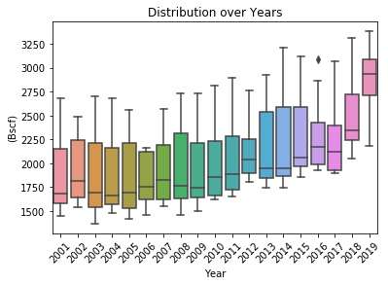
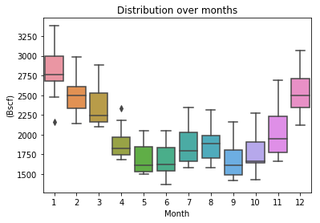
Data Exploration – Time Trend Analysis
Consumption has been increasing over the years
Drastic intra-year consumption variations

Slide 4
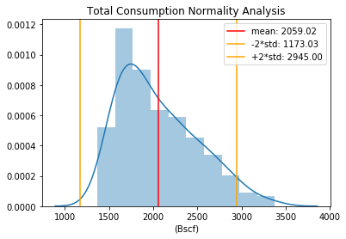
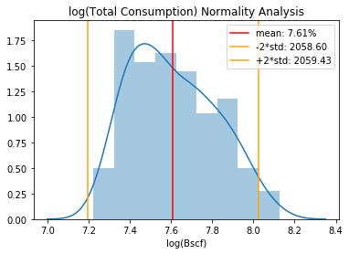
Data Exploration – Normality Analysis
Normality Test: Shapiro Test
p = 1.2 x 10⁻⁷
Normality Test: Shapiro Test
p = 9.4 x 10⁻⁵

Slide 5
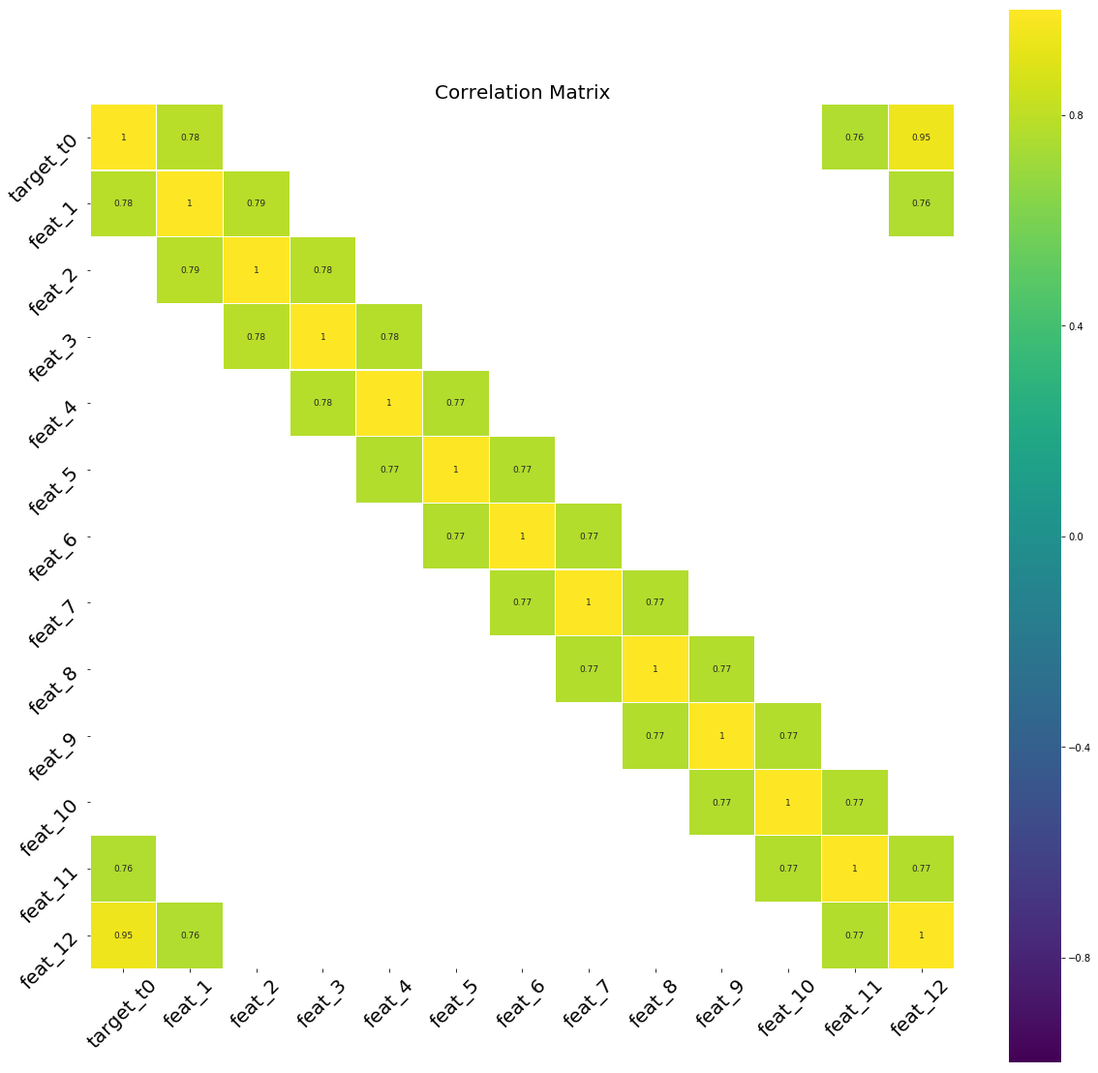
Data Exploration –Correlation Matrix

Slide 6
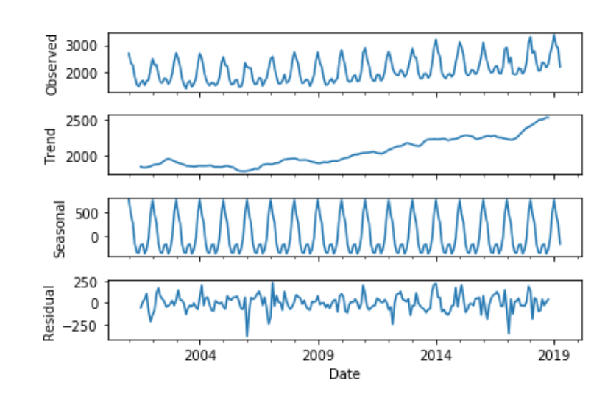
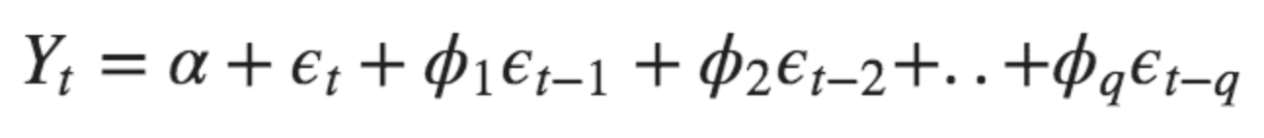
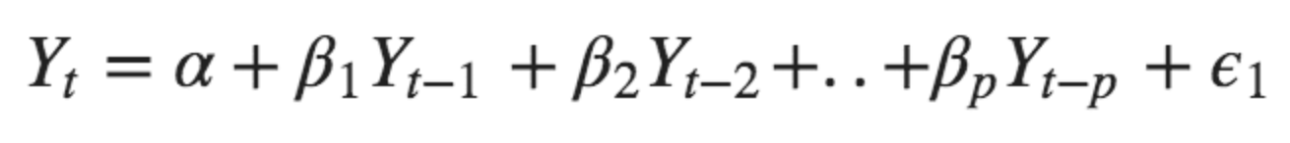
Econometric Model – ARIMA
Autoregressive Formula:
Moving Average Formula:

Slide 7
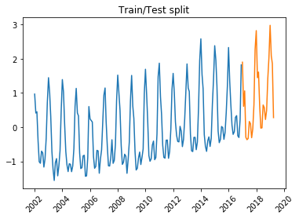
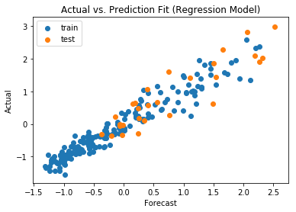
Machine Learning Model – Linear Regression
Train RMSE: 0.25
Test RMSE: 0.42
Train R2: 0.93
Test R2: 0.81

Slide 8
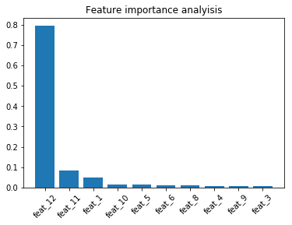
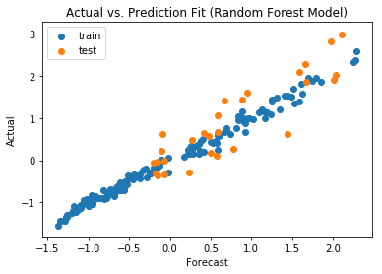
Machine Learning Model – Random Forest
Train RMSE: 0.10
Test RMSE: 0.47
Train R2: 0.99
Test R2: 0.77

